Slide 1
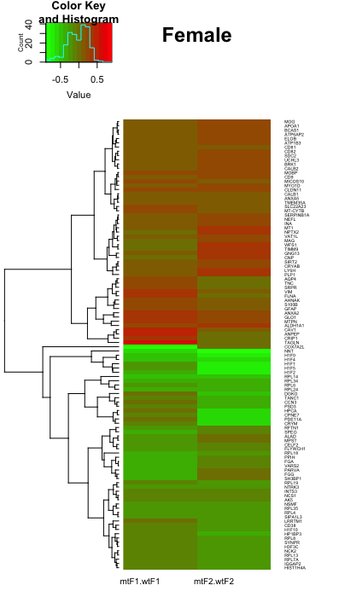
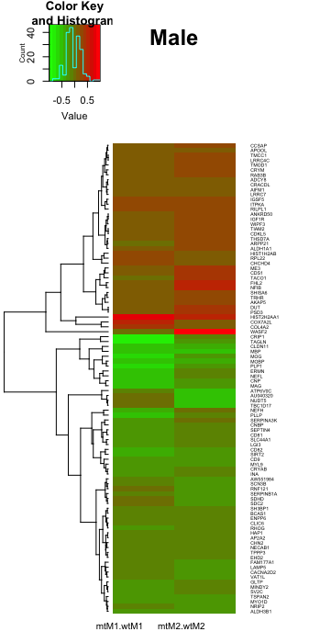
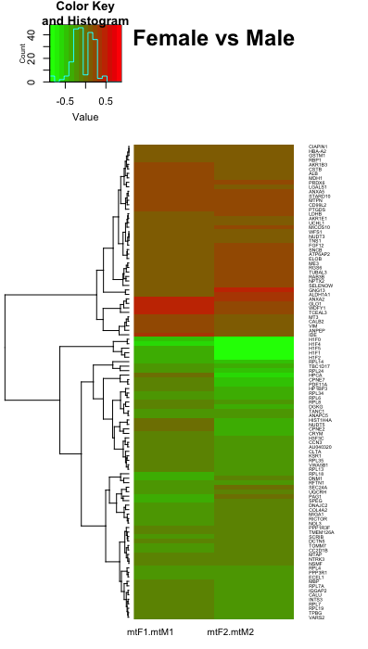
Fig. 8
(A)
mtF/ctrF
(B)
mtM/ctrM
(C)
mtF/mtM
MOG
APOA1
BCASt
ATP?AP2
ELO5
ATP182¿
CD81
CD82
UCHL3
BANKT
CAW2
MOBP
CD9
MICOSTO
MYOD1
CLDN11
CALB1
ANXA
TMEM25A
SLC22A23
MT-CTTB
SERPINB1A
NEFL
INA
MT1
NPTX2
VAT1L
MAG
WP51
TIMM5
GNG13
CNP
SIRT2
CRYAB
LYSM
PLP1
AOPM
TINO
SPRP
VIM
FLNA
AJINAL
SIOD6
GFAP
ANXA2
GLO1
NTPN
ALDH1A1
CAV1
ANPEP
CHP1
TABLN
COOKPAZ2
NNA
H1F0
H1F4
H1F1
H1F5
H1F2
RPL14
RPL34
RPL5
RPL24
Cok6
Tankc1
Ccn3
Pbd3
Hpca
Cpinet
Pde11a
Crym
Rftn1
Speb
Alad
Mpst
Ceuf2
FLYADH
RPL18
FPP1H
FGA
WXRS2
RARWA
FGG
SH2GP1
RPL19
NTRK3
NCS1
AN2
NAVF
RPL35
RPL4
SIPA1L3
LRRTM1
CD38
H1F10
HPGP3
RPL8
SYNPR
HDF2C
NCK2
RPL13
RPLPA
IQGAP2
H15T1H4A
mtF1/ctrF1
mtF2/ctrF2
mtM1/ctrM1
mtM2/ctrM2
mtF1/mtM1
mtF2/mtM2
Notes:
Heatmaps: Proteomic Analysis of Foxp2+/- MeA

Slide 2
Fig. 8
(A)
mtF/ctrF
(B)
mtM/ctrM
(C)
mtF/mtM
mtF1/ctrF1
mtF2/ctrF2
mtM1/ctrM1
mtM2/ctrM2
mtF1/mtM1
mtF2/mtM2
Notes:
Heatmaps: Proteomic Analysis of Foxp2+/- MeA

